Slide 1
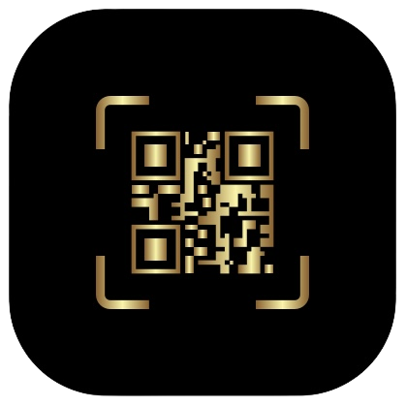
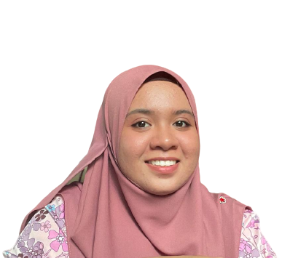


SIGNSAFE: SIGNATURE AUTHENTICITY SYSTEM
FOR CONFIDENTIAL DOCUMENTS
USING WEB-BASED SECURE ACCESS
NAMA: NUR AZILA BINTI MUHAMMAD
MATRIC NO: 1190507
SUPERVISOR: DR. MURTADHA ARIF BIN SAHBUDIN
SKJ4272 FINAL YEAR PROJECT 1 PRESENTATION

Slide 2

Digital identities are increasingly important in the modern life which are used for various purposes, including opening a bank account, online shopping, and more.
The term "eco-friendly" can be applied since the paper produced from the plant is not being used. (Hertlein et al.,2017)
Creating a signature authenticity system for the confidential document using web-based secure access is to produce a list of digital files that may be used as documents with the same validity as paper documents.
Allowing the use of this system to be synced with paper-based documents in the future by considering the vulnerabilities in a printed confidential copy. (Lax et al., 2015)
Generally, paper documents can be displaced and damaged. (Olexa & Grant, 2018)
I
N
T
R
O
D
U
C
T
I
O
N
I
N
T
R
O
D
U
C
T
I
O
N

Slide 3
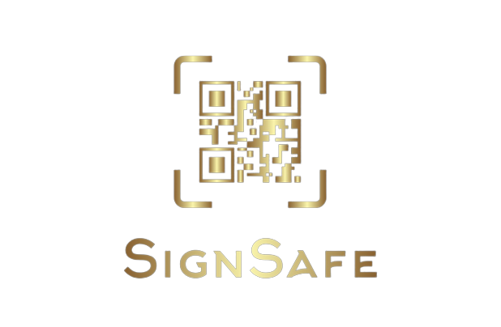
INTRODUCTION
Problem Statement
LITERATURE
REVIEW
Inconsistency signatures are due to ageing, sudden problems in writing hand and mood fluctuations. (Desarkar et al., 2019)
Identity fraud that can provide invalid data. (Hertlein et al.,2017)
Time and money constraints cause the signature vulnerable to be fabricated or signed by an unauthorized person. (Anood et al.,2018)
COMPARISON
Can Be Solved?
METHODOLOGIES
NO
YES
EXPECTED
RESULT
MILESTONES
CONCLUSION

Slide 4
Research Questions
INTRODUCTION
1. What is the present issue with digital signatures on confidential online documents?
2. How can web-based secure access be used to verify the signature authentication system?
3. How will the security features of the proposed web-based system be implemented?
Project Scope
Implementation of a web-based user account
Implementation of generating QR code signature
Verification of authenticity of QR code signature
Protection of data and information
Research Objectives
1. To examine the present issues related to the digital signatures on confidential online documents.
2. To create and develop web-based secure access which a QR code to authenticate the signature.
3. To implement authentication to protect the proposed web-based system against any violation.

Slide 5
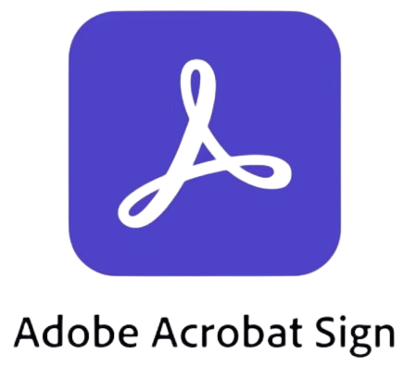
EXISTING SYSTEM
Smart Card
INTRODUCTION
Adobe Sign
In Adobe Acrobat DC,
the signature dictionary
stores information needed
for digital signature services
such as signatures, contents
and certificates. As a result,
while creating or verifying
digital signatures, PDF applications should use the signature dictionary. (Nur, Adams & Brailsford, 2016)
LITERATURE
REVIEW
The user is identified via a private key while showing the smart card and certain built-in security features in the application, in addition to electronically reading the information stored on the smart card. (Hertlein, 2017)
Tablet PC
A portable device can capture signature signals at a low cost that will include the acceptance of a written signature as proof of identity on a social and legal level. (Alonso-Fernandez, 2015)

Slide 6
Comparison of SignSafe, E-Signature & Paper Signature
INTRODUCTION
Comparison | SignSafe | E-Signature | Paper Signature
Identity | A web-based signature authentication system that uses a QR code which concerns confidentiality, non-repudiation and integrity. | The signatory must prove that the document was signed by him or her and that it has not been tampered with in any way. | A signature server is used to identify the signatory because each person's signature is unique.
Security | A strong encryption method such as multi-factor authentication. | Limited security features. | No tampering or complete security is possible.
Evidence | QR Code: Document’s Title Signatory's Name Date & Time Location (Optional) Email (Optional) | Cannot be tracked or validated the signature. Difficult to prove the document’s signer and must be kept securely. | Cannot be tracked the location and time of the document signed. A witness is important when signing the documents.
Filling Time | Directly (Instant) at anywhere and anytime. | Directly (Instant) at anywhere and anytime. | Some period of time like 2-3 weeks needed.
LITERATURE
REVIEW
COMPARISON

Slide 7

Research Methodology
INTRODUCTION
Analysis
Design
Maintenance
Implementation
Testing
LITERATURE
REVIEW
WATERFALL
COMPARISON
METHODOLOGIES
One of the most
straightforward and
manageable approaches.
This small project will benefit from the Waterfall paradigm.
(Aroral, 2021)

Slide 8





05
Maintenance
There are various types of maintenance needed to keep a system running like corrective, adaptive, perfective and preventive maintenance. (Burch, 2017)
INTRODUCTION
LITERATURE
REVIEW
04
System Testing
This testing will cover the entire system and ensure that it meets the standards. During this phase, bugs and device vulnerabilities are found, fixed, and improved.
COMPARISON
03
System Implementation
This system implementation stage entails turning all of the designs into machine-readable code. This is the most time-consuming step of the Waterfall life cycle process. (Kramer, 2018)
METHODOLOGIES
02
System Design
This phase concludes with a description of how the system should be built and implemented. Develop a straightforward and efficient design style. (Kramer, 2018)
01
Requirement Analysis
The waterfall model attempts to evaluate needs from the start and did not allow the implementation to begin until all requirements have been fully understood, documented, and substantially fixed. (Demirel & Das, 2018)

Slide 9
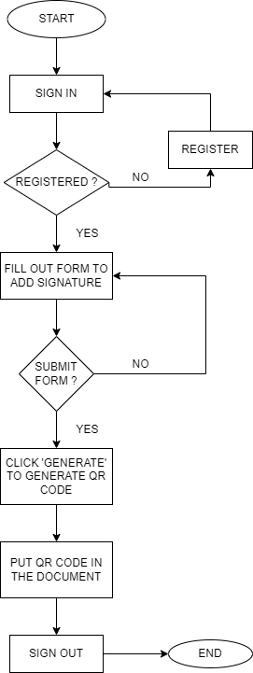
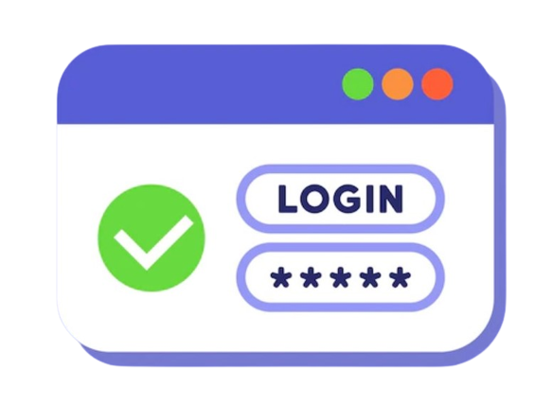

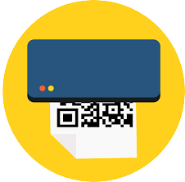


How does the Proposed System work?
INTRODUCTION
Log in to the system
LITERATURE
REVIEW
2. Add signature form
COMPARISON
3. Generate QR Code
METHODOLOGIES
4. Upload the document
5. Put the QR code to the document
FLOWCHART

Slide 10
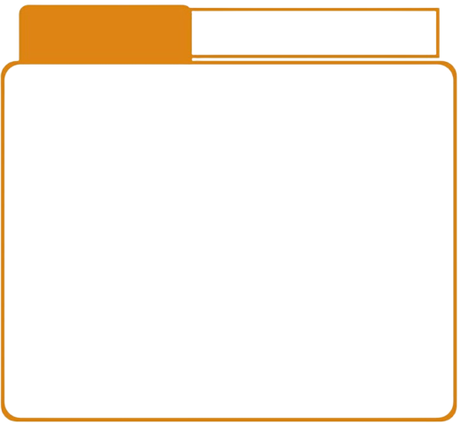

SYSTEM
IMPLEMENTATION
Web-Based Development Tools
INTRODUCTION
SYSTEM
TESTING
TOOLS
PHP | To create a dynamic and appealing web-based system that meets the needs of the user. In comparison to Java/.NET, PHP programs are simple to construct.
HTML5 | A collection of linked technologies using HTML, JavaScript, and CSS to construct a high-performance web-based system without the use of plugins.
phpMyAdmin | The user interface can be used to manage common operations including databases, tables, columns, relations, indexes, users, and permissions while also running SQL commands directly.
QR Code Generator | QR codes may hold a variety of data types and have a large storage capacity (Furht, 2011).
LITERATURE
REVIEW
Usability
Testing
Functional
Testing
(Black-box
Testing)
COMPARISON
METHODOLOGIES

Slide 11
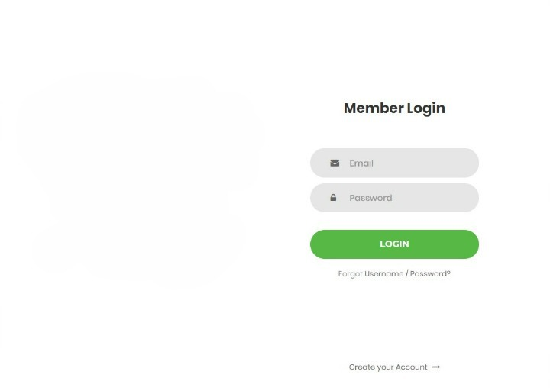
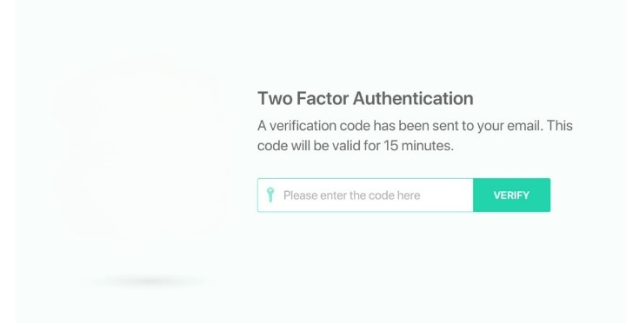
Interfaces
INTRODUCTION
The expected result after QR code had been scanned by 3rd party
Register
LITERATURE
REVIEW
COMPARISON
Unique URL link
Document Title: ____________
Name: ___________________
Date: (Auto Generate)
Time: (Auto Generate)
Location: Optinal
Email: Optinal
Notes: Optinal
User Login Interface
Multi-Factor Authentication Interface
METHODOLOGIES
EXPECTED
RESULT
Notes:
Credential of the user
PDF document
Word Excel Powerpoint
Challenges:
Require more test cases to be done (more time)
Unique URL link using blockchain

Slide 12
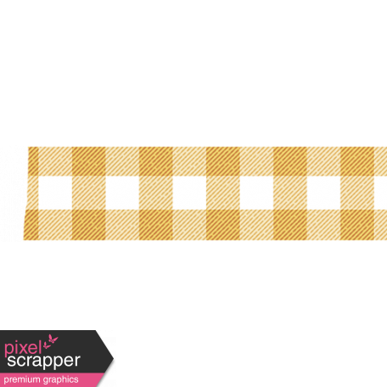
GANTT CHART
INTRODUCTION
LITERATURE
REVIEW
COMPARISON
METHODOLOGIES
EXPECTED
RESULT
MILESTONES

Slide 13

GANTT CHART
INTRODUCTION
LITERATURE
REVIEW
COMPARISON
METHODOLOGIES
EXPECTED
RESULT
MILESTONES

Slide 14
INTRODUCTION
To conclude, this system’s goal is to have a positive impact on society and corporate environments by reducing fraud and forgery and assisting in the control of the signing process for contracts or private documents.
Problem statements:
Inconsistency signatures can be avoided.
There will be no identity fraud cases happen.
Every user can sign confidential documents anytime and everywhere without thinking about the signature vulnerable.
CONCLUSION
LITERATURE
REVIEW
COMPARISON
METHODOLOGIES
EXPECTED
RESULT
MILESTONES
CONCLUSION

Slide 15
SEE YOU ON THE NEXT PRESENTATION
References
…
Al, A., Alzahrani, M., Alfosail, M., Aldossary, M., Almuhaidib, S., Alqahtani, N., Saqib, K., Alissa, N., & Almubairik. (2018). Secure Sign: Signing Document Online.
Alonso-Fernandez, F., & Fierrez, J. (2015). Secure access system using signature verification over tablet PC Fusion of Spatio-Temporal Information for Footstep Recognition. View project ICCST-2017: 51st International Carnahan Conference on Security Technology View project. Secure Access System Using Signature Verification over Tablet PC. https://doi.org/10.1109/MAES.2007.351725
Aroral, H. K. 2021. Waterfall Process Operations in the Fast-paced World: Project Management Exploratory Analysis. International Journal of Applied Business and Management Studies, 6(1), 91–99.
Burch, J., & Grupe Payoff, F. (2017). 4-05-10 A Systems Approach to Software Maintenance.
Desarkar, A., Sanyal, S., Baidya, A., Das, A., & Chaudhuri, C. (2019). Innovative Outlier Removal Techniques to Enhance Signature Authentication Accuracy for Smart Society. International Journal of Distributed Systems and Technologies, 10(2), 64–83. https://doi.org/10.4018/ijdst.2019040104
Hertlein, M., Manaras, P., & Pohlmann, N. (2017). Smart Authentication, Identification and Digital Signatures as Foundation for the Next Generation of Eco Systems. Digital Marketplaces Unleashed, 905–919. https://doi.org/10.1007/978-3-662-49275-8_80
Kramer, M. 2018. BEST PRACTICES IN SYSTEMS DEVELOPMENT LIFECYCLE: AN ANALYSES BASED ON THE WATERFALL MODEL. Review of Business & Finance Studies, 9(1), 77–84. https://ssrn.com/abstract=3131958www.theIBFR.com
Lax, G., Buccafurri, F., Caminiti, G. 2015. Digital Document Signing: Vulnerabilities and Solutions. Information Security Journal: A Global Perspective, pp 24 (1-3) 1-14.
Nur, S., Adams, C. E., & Brailsford, D. F. 2016. Using built-in functions of Adobe Acrobat Pro DC to help the selection process in systematic reviews of randomised trials. Systematic Reviews, 5(1). https://doi.org/10.1186/s13643-016-0207-7
Olexa, M., Grant, L. 2016. Replacing Lost or Damaged Documents. IFAS [Internet]. Florida: Extension University of Florida. Accessed April 11, 2018, from: http://edis.ifas.ufl.edu/pdffiles/DH/DH21500.pdf
THANK YOU

